Slide 1


Introduction to
School Nursing
MODULE II
School Nurse Practice

Slide 2
Topics
Assessment
Planning
Implementation
Evaluation
Chronic Disease Management
Life-Threatening Health Conditions
IHPs / ECPs / 504s
Staff Training
Delegation
Documentation

Slide 3
ASSESS STUDENT
HEALTH NEEDS

Slide 4
Nursing Assessment
Health Registration Form
The first step in the nursing process is to perform a nursing assessment.
Gather your data:
  Student health information form—review on every student, every year
  Student health record, if there from previous years
  Interview the student, the parent, school staff
  Health care provider records

Slide 5
Nursing Assessment
Students that have an identified health condition require a thorough assessment of the students health status, history and current problems. This includes gathering information from the student, family and LHP.
Quickly secure written permission from the parent/ guardian to exchange information with the LHP to facilitate the assessment.
If a student requires medication or a medical treatment at school, give the parent an appropriate authorization form that provides instructions to safely manage the student’s care at school.

Slide 6
Life-Threatening Health Conditions
For students with a possible life threatening health condition, BEFORE attending school, there are 4 requirements:
A medication or treatment order that has been signed by the LHP and the parent must be at the school.
The medication or equipment identified in the order must be at the school.
A nursing plan must be in place,
School staff must be aware of the condition and how to respond.
Refer to RCW 28A.210.320 and WAC 392-380-045

Slide 7
Life-Threatening Health Conditions
Reminders:
It is imperative that the RN communicate with the school administrator if it is unsafe for a student to be at school when orders, medication, supplies, care plan and necessary training are not in place.
The chief administrator of each public school is responsible for exclusion.

Slide 8
PLAN FOR STUDENT HEALTH NEEDS

Slide 9
Nursing Care Plans
Following a thorough and holistic assessment, the RN identifies student health concerns and develops an individualized plan of care.
Some students have:
complex needs that require special care to assist them throughout the school day
health conditions that present risk for health care emergency
health conditions that require assistance with activities of daily living and are also at risk for an emergency event

Slide 10
Why Write a Care Plan for School?
It is written by you---for you... it documents that you are providing the needed care for a student.
It is written for teachers and paraprofessionals...so they know what the health expectations are for this student.
Most of all it is written for the student... it assures
them the care needed to successfully participate
and be available for learning in school.

Slide 11
IHPs | ECPs | 504s
INTRODUCTION TO PLANS

Slide 12
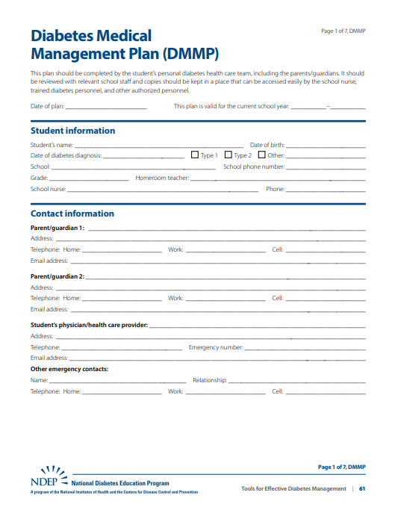
Student Plans
IHPs - Individual Healthcare Plans
ECPs - Emergency Care Plans
IEPs - Individual Education Program
504 Student Accommodation Plans

Slide 13
Individualized Health Plan (IHP)
Written by the RN to direct care for students.
Based on a nursing assessment and developed for a student’s daily management of their health condition.
Can either be a broad, comprehensive plan that addresses the holistic student needs or a brief plan.
Based on a nursing assessment and developed for a student’s daily management of their health condition.
A “living” document that may need revisions as the students health status changes.
Video IHP Overview: https://youtu.be/7sKqOtIBYrU

Slide 14
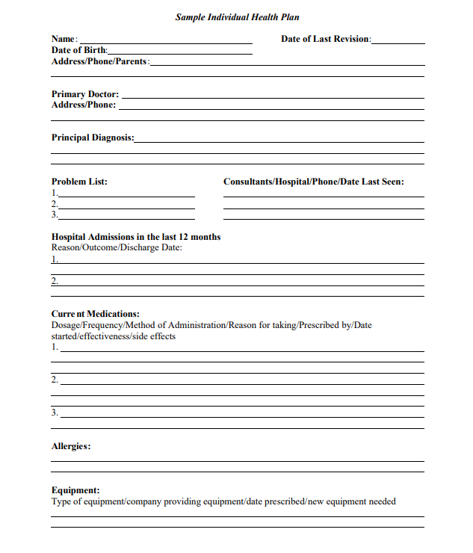
Generic Individual
Health Plan
Student Demographic Info
Primary Diagnosis
Problem List
Hospitalization History
Allergies
Medications
Equipment
Medical History
Review of Body Systems
Pacer Center: https://www.pacer.org/health/pdfs/ind_health_plan.pdf

Slide 15
Emergency Care Plan (ECP)
Clear instructions, written in lay language, to guide unlicensed assistive personnel (UAP) when responding to a health emergency.
Ensure access to staff who will use it.
Serves as documentation of actions.
Provide copies to EMS and hospital to support communication.

Slide 16
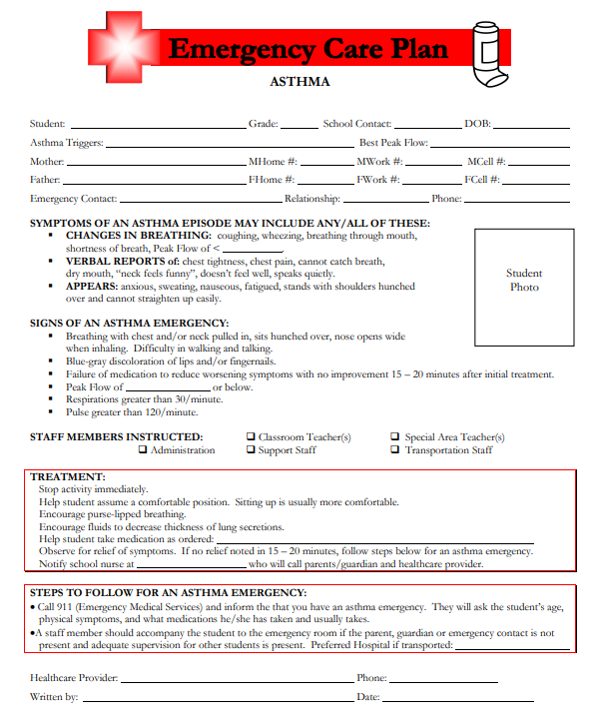
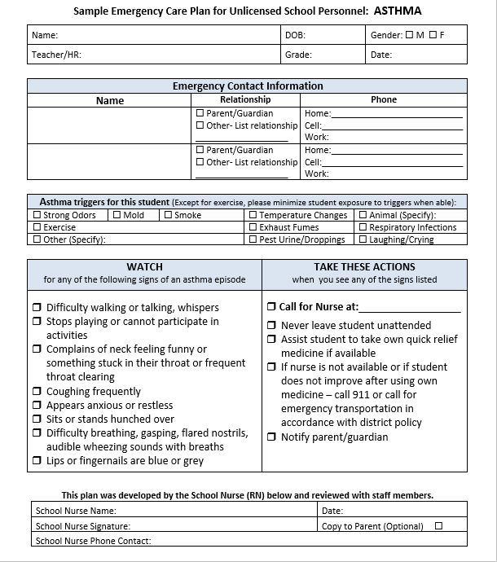
Emergency Care Plan: Asthma
Ellicottville Central Schools, New York

Slide 17
504 Plan
504 Plans list accommodations in school to ensure that a student has access to a free and appropriate education (FAPE) experience.
Students who may qualify for a 504 plan may be having their needs met through the IHP. In this case the 504 accommodations would be incorporated into the IHP.

Slide 18
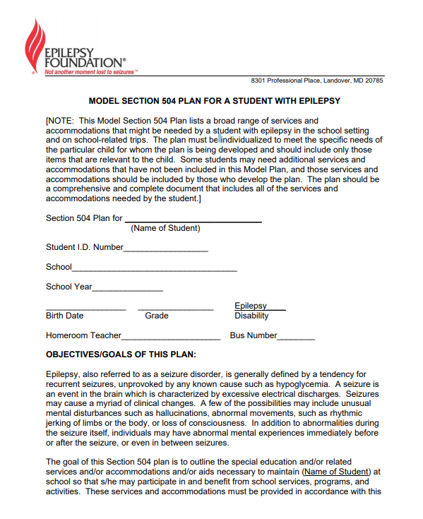
Model 504 Plan: Epilepsy
Template for individualized content
8 page plan that includes accommodations, field trips, emergency evacuation, etc.
Epilepsy Foundation

Slide 19
Components of IHP/ECP/504 Plan
Diagnosis/Condition
History-severity, frequency, time of last episode
Triggers
Symptoms
Treatment intervention/s for condition
Accommodations
All medications student takes
All known allergies
Health care provider-hospital
Signatures

Slide 20
Who Signs the Care Plan?
RN: An RN signature is required on all care plans.
LHP: Indicates accuracy to assure plan is what LHP expects. Required if medications or treatments are ordered.
Parent/Guardian: Indicates accuracy and clarifies expectations of how school will respond in an emergency and indicates that RN is partnering with the family to formulate the plan. Required if medications or treatments are ordered.
Student: Indicates that the student is an active part of the care team and sets the stage for the student taking responsibility for their health care

Slide 21
Care Plan Checklist
Checklists are useful to track progress as you develop and implement IHP/ECP/504 Plans

Slide 22
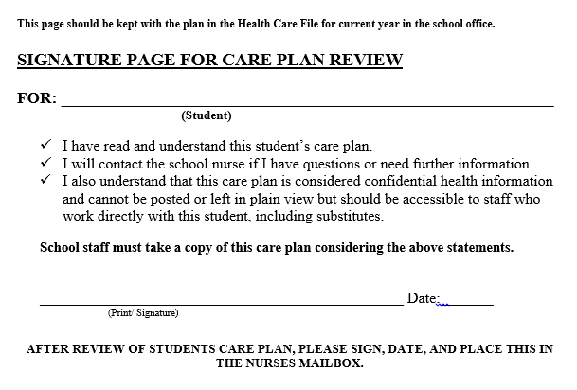
Care Plan Review

Slide 23
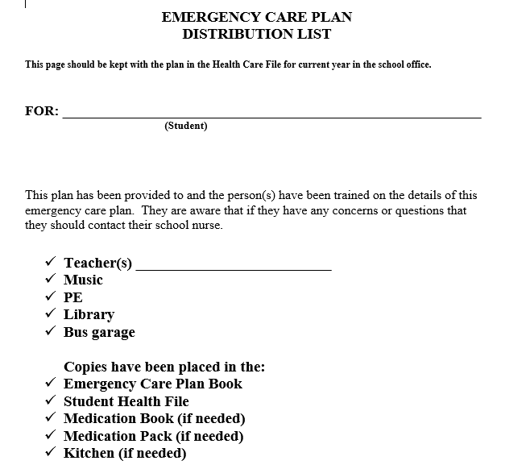
Care Plan Distribution

Slide 24
Life-Threatening Health Conditions
ANAPHYLAXIS | ASTHMA | DIABETES | SEIZURES

Slide 25
Communication and Planning
It is critical to partner with the student’s parent, not alienate the parent.
Communicate needs clearly to Superintendent. Focus on student safety concerns, not “license concerns”.
Plan ahead for medical emergencies and emergency transportation, including air evacuation support.

Slide 26
ANAPHYLAXIS

Slide 27
ANAPHYLAXIS
…Is a life-threatening allergic reaction that involves 2 or more body systems
…Is a medical emergency requiring immediate medical treatment with activation of Emergency Medical Services (EMS)
Refer to: OSPI Manual “Guidelines for Care of Students with Anaphylaxis”

Slide 28
Common Causes
Peanuts
Tree Nuts
Milk
Eggs
Crustacean Shellfish
Wasps / bees
Medication
Latex
Wheat
Soybeans

Slide 29
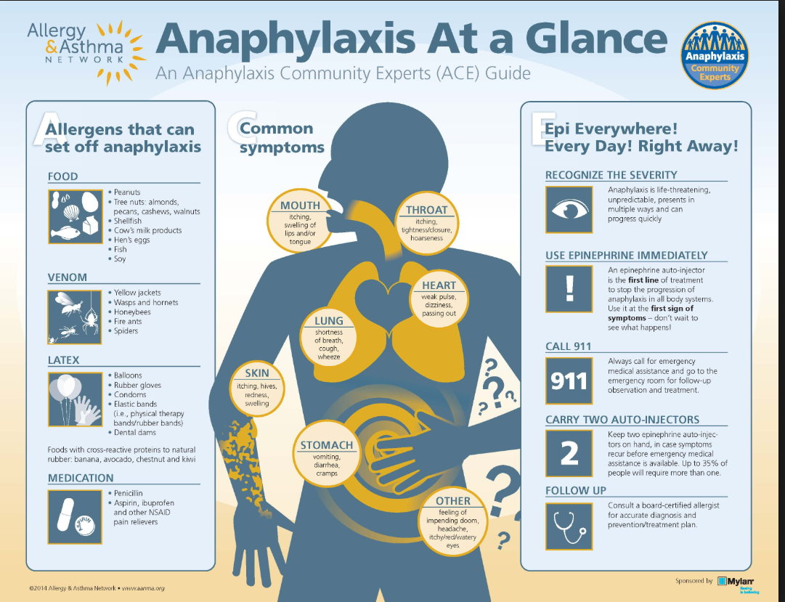

Slide 30

https://www.youtube.com/watch?v=FXlqSuzzrws

Slide 31
ANAPHYLAXIS GUIDELINES
The school district is responsible for the development of an individualized emergency care plan by an RN. Plan components must include:
Training school staff on identifying the problem and their role
A plan to inform staff that need to know
Strategies to reduce the risk of exposure to the allergen
Dietary prescriptions
  Refer to: RCW 28A.210.380; RCW 28A.21o.370

Slide 32
Stock Supply Epinephrine Auto-Injectors
If an LHP with prescriptive authority writes an order for stock epi use in a school setting, the school may maintain stock epi injector pen(s).
Schools must follow state guidelines and restrictions on allowable number of injectors, storage and administration.
School nurse or designated trained school personnel may utilize the school district or school supply of stock epi for students with a prescription.
Only the school nurse may utilize a school’s stock epi for students without a prescription. If the school nurse is not available, unlicensed school staff should immediately call 911.
Refer to: RCW 28A.210.383

Slide 33
ASTHMA

Slide 34
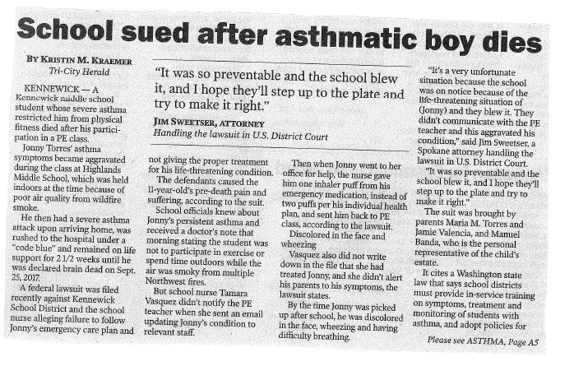

Slide 35
Asthma Guidelines
Policies regarding asthma rescue procedures, including authorization for self administration of asthma medication.
LHP-prescribed medication and instructs student in correct use.
Student demonstrates proper technique to the school nurse for administration of med.
Refer to: RCW 28A.210.370

Slide 36
Asthma Guidelines
Student’s parent/guardian provides medication.
Medication authorization and IHP/ECP/504 must be renewed each year.
Medication authorization and plans are effective only for the SAME school and school year.
A student may self-carry and self-administer asthma medication at school and school sponsored events when parent, nurse and principal agree that it can be done safely.

Slide 37
Asthma Considerations
Students with asthma may qualify for 504 accommodations.
Students with both asthma and anaphylaxis need integrated plans to ensure both conditions are appropriately managed.
If back-up med is provided, it must be kept in a location that the student has immediate access to.
A student may self-carry and self-administer asthma medication with a written treatment plan for self-managing asthma episodes

Slide 38
Asthma & Anaphylaxis
A dual diagnosis of asthma + anaphylaxis greatly increases risk of death.
Care plans must clearly state that the student has 2 diagnoses - asthma + anaphylaxis .

Slide 39
DIABETES

Slide 40
Diabetes
For children with diabetes to be successful in school, a comprehensive health plan must be cooperatively developed by families, school personnel, and the LHP.
Refer to: 2018 OSPI Manual: Guidelines for Care of Students with Diabetes

Slide 41
Diabetes Guidelines
An IHP should be in place in the student’s school and should include provisions for:
Parental signed release of health information.
Parental signed consent for treatment at school form.
Medical equipment and storage capacity.
Exceptions from school policies.
School schedule.
Meals and eating.
Disaster preparedness.
Inservice training for staff.
Legal documents for PDAs if needed.
Personnel guidelines describing who may assume responsibility for activities contained in this plan.
Refer to: RCW 28A.210.330 to 350

Slide 42
Diabetes Planning Packet
Sample Forms:
  Planning Checklist
  Diabetes History form
  ECP for hypoglycemia and hyperglycemia
  504 Plan – including consent form
  Exchange of Information
  Parent Designated Adult (PDA)

Slide 43
Diabetes PDA
PDA
A volunteer, who may be a school district employee, who receives additional training from a health care professional or expert in diabetic care selected by the parents, and who provides care for the child consistent with the IHP.
To be eligible to be a PDA, a school district employee shall file, without coercion, a voluntary written, current, and unexpired letter of intent stating the employee's willingness to be a PDA. If a school employee chooses not to file a letter, the employee shall not be subject to any employer reprisal or disciplinary action for refusing to file a letter.

Slide 44
SEIZURES

Slide 45
Seizure Guidelines
Requirements for the care of students with life threatening seizures are addressed in:
RCW 28A.210.260 Public and Private School Administration of Medication
RCW 28A.210.320 Children with Life-threatening Health Conditions
Resources:
Epilepsy Foundation
NCQAC Registered Nurses Coordination Seizure Management

Slide 46
NCQAC Guidance on Seizures
In the schools setting, registered nurses are responsible for the coordination of care for students with seizure disorders. They collaborate with family members, health care providers in the community, and other licensed and unlicensed assistive personnel to create individualized plans for care.
NCQAC Registered Nurses Coordination Seizure Management

Slide 47
Seizure Plan Development
Develop IHP/ECP/504 including:
Seizure history
Triggers
Seizure classification
Medication/Devices
Acuity level
Personnel available and willing to carry out IHP/ECP/504

Slide 48
Seizure PDA
RCW 28A.210.260 allows parents to designate an adult (PDA) to provide seizure care consistent with the student’s IHP.
The PDA is a volunteer who receives additional training from a healthcare professional or expert in epileptic care, selected by the parent/guardian.
To be eligible to be a PDA, a school district employee shall file, without coercion, a voluntary written, current, and unexpired letter of intent stating the employee's willingness to be a PDA.

Slide 49
IMPLEMENTATION

Slide 50
Implementation Steps
Staff Training to Care Plan
Delegation
Documentation of Delegation
Distribute Care Plan to Staff

Slide 51
STAFF TRAINING

Slide 52
Levels of Staff Training
General Training
General level training is required for school staff indirectly involved with the student.
Intensive Training
Student specific training for staff directly responsible for implementing the student’s care plan.

Slide 53
Staff Training Topics
All Staff:
  BBP
  Asthma
  Anaphylaxis
  Diabetes
  Seizures
Appropriate Staff:
Medications, Field Trips, Treatments, Concussions
Refer to: Washington State School Staff Health Training Guide

Slide 54
Who Needs What Training?
School office staff—usually are primary health care givers and medication administration
Teachers—consider how often they take students off campus, they may need med admin training
Bus drivers—they are alone with students and the sole responsible adult for sometimes hours
Coaches—the activities students are involved in make them at increased risk for asthma and anaphylaxis
Paraeducators (Paras)—they assist students at recess when asthma or bee stings are more likely to occur, risk of blood exposure

Slide 55
Planning Trainings
Who | What | When
School Office | Meds, ECPs | Before School Starts
Teachers | Med Information Access, ECPs | Before School Starts
Bus Drivers | ECPs, EpiPens, Emergency Response | 1st 2 weeks
Coaches | Meds, EpiPens, Concussions, Things to Report to Nurse | 3 X year Each season
Paras, Custodians, Food Service | BBP, ECPs | Varies

Slide 56
Online Staff Training: SafeSchools
May partially meet district compliance for mandated staff training. Nurse should be available to answer questions.
Must still be combined with in-person training for all IHPs, ECPs and delegated skills-related training.
Record attendance on roster.

Slide 57
Prep for Trainings
Meet with Administrators early—June or August—and make a tentative plan, negotiating time and clarifying what on-line training staff will have had.
Roster sheet
Handouts and training supplies
Decide if presentation equipment is needed
Use adult learning principles

Slide 58
Prep for Diabetic Training
Meet with parent ASAP to determine level of care needed (PDA?, LHP orders); write plan.
Student may not start school unless staff training is complete: unless nurse will provide all care.
All staff in building to receive training on care plan.
Small group will need intensive training - those who will be with student throughout the day.
PDA bus drivers require glucagon administration training.

Slide 59
DELEGATION

Slide 60
Delegation Definition
Transferring a nursing task to another competent individual who would not normally be allowed to perform the task.
(NCQAC)

Slide 61
Delegation in Schools
School Nurse delegation holds the most risk for student health, district liability and the nurse’s professional practice is delegation of nursing care to unlicensed staff.

Slide 62
Delegation of Tasks
An RN may delegate nursing care tasks to other individuals where the RN determines that it is in the best interest of the patient.
Refer to: RCW 18.79.260

Slide 63
Responsibility & Supervision
The RN delegating the tasks retains the responsibility and accountability for the nursing care of the client.
The RN delegating the task supervises the performance of the unlicensed person.
Refer to: WAC 246-840-010

Slide 64
RNs May NOT Delegate To:
Volunteers
Parents
Non-School Employees
Parent Designated Adults (PDAs)
LPNs

Slide 65
Who May NOT Delegate?
Licensed Practical Nurses
Health Room Assistants
School Administrators
Teachers
Office Staff
Coaches
Bus Drivers
EMTs
PAs

Slide 66
Principles of Delegation
The RN:
• Takes responsibility and is accountable for providing nursing care
• Directs the care and determines whether delegation is appropriate
• Delegates specific tasks but not the nursing process
• Should be involved in establishing systems to assess, monitor, verify, and communicate ongoing competency requirements in areas related to delegation

Slide 67
Principles of Delegation
The RN:
Uses nursing judgment concerning a student’s condition, the competence of the UAP, and the degree of supervision required prior to delegation.
The RN delegating the task supervises the performance of the unlicensed person.
Delegates only those tasks where the UAP has the knowledge, skill, and ability to perform the task safely (considering training, cultural competence, experience, regulations, and institutional policies and procedures).

Slide 68
Principles of Delegation
The RN:
• Communicates and verifies comprehension and acceptance of delegation and responsibility (consider a letter of intent to accept delegation based on law and school policy in instances where the task is not previously recognized in law).
• Provides opportunities for the UAP to ask questions and clarify expectations.

Slide 69
Principles of Delegation
The RN uses critical thinking and professional judgment when following the Five Rights of Delegation:
Right task
Right circumstances
Right person
Right directions and communication
Right supervision and evaluation
Refer to NCSBN (1995)

Slide 70
Process of Delegation Tools
School Registered Nurse Delegation Decision Tree
Scope of Practice Decision Tree
Recommended Staffing for School Health Services Decision Matrix
Notes:
.

Slide 71
Process of Delegation Actions
Assess student needs
Delegation Decision Tree (is delegation appropriate?)
RN has knowledge and experience to delegate the task
Willing, competent , and available UAP
Develop a training plan
Train, including demonstration and return demonstration
Delegate task to UAP
Supervise and evaluate UAP on a regular basis

Slide 72
Documentation of Delegation
The delegating RN should document the delegation process using the fundamental principles of nursing documentation:
Document specific steps for the delegated task
Consider using a system where the RN and UAP initial each step in the document for delegated task
Include date(s), training, and competency assessment with RN and UAP signatures

Slide 73
Delegation Reminders
Provide clear instructions to the UAP including
When and how to contact delegating RN with questions or concerns
What constitutes an emergency
What to do in an emergency
Notify building administrator if a task is unsafe to delegate, and recommend alternative plan.

Slide 74
Tasks that may NOT be delegated
Administration of rectal medication or injections (except epinephrine injection)
Acts requiring substantial skill
Piercing or severing of tissue
Acts that require nursing judgment
Medical procedures that the RN determines are not in the best interests of the student

Slide 75
Transferring Delegation
Delegation authority cannot be transferred from one RN to another.
If the delegating RN is no longer assigned to a student or group of students, the RN assuming authority must undertake new delegation to the UAP.

Slide 76
When to Rescind Delegation
School RNs delegating care retain the authority to rescind delegation when:
A significant change or decline in the student’s health status makes delegation unsafe.
The UAP lacks sufficient training, knowledge, skills, or ability to perform a task safely and competently.
A determination that the specific task requires nursing judgment.

Slide 77
When to Rescind Delegation
There is a change in school nurse assignment or school nurse turnover.
The school nurse is no longer employed by the school or school district or there is a change in the school nurse’s assignment.
The school nurse is no longer under contract (for example, during summer vacation).

Slide 78
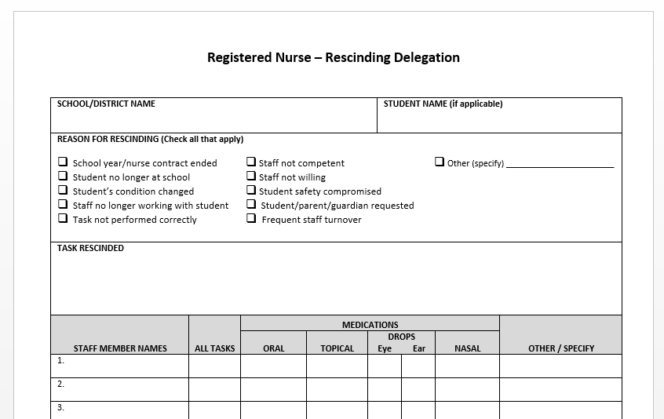
Rescinding Delegation

Slide 79
Distribute Care Plan
Distribute Care Plans to Appropriate Staff
Documentation

Slide 80
Evaluation

Slide 81
Evaluation of Care and Plan
The assessment and IHP/ECP are part of an ongoing process of providing school-based care. The last step in the nursing process is Evaluation. This may include:
Ongoing supervision of any delegated tasks and implementation of any needed revision in the plan with periodic review and retraining related to care
Annual review of plan including a reassessment of student needs.
Training of any new staff involved with the student

Slide 82
DOCUMENTATION

Slide 83
Documentation Definition
Documentation is preparing or assembling records to authenticate the care given to students and the rationale for giving that care.
Documentation is critical to the development and maintenance of a high-quality school health program.
It is essential to the practice of professional nursing and is a fundamental component of the nursing process.

Slide 84
Documentation Guidance
Nursing documentation should be accurate, objective concise, thorough, timely, and well organized.
Entries should be legible and written in black or blue ink. Do not erase or use white-out. Draw a single line through an error, initial and date the entry, and write the correct entry following the section that has been struck out.
The date and exact time should be included in each entry.

Slide 85
Documentation Guidance
Any nursing action taken in response to a student problem should be documented.
Both positive and negative findings should be included in the nursing assessment data.
All progress notes, individualized health care plans, flow charts, etc. should be kept current.

Slide 86
Documentation Guidance
Documentation should include only objective, essential information.
Precise measurements, correct spelling, and standard abbreviations should be used.
Objective data should not include personal judgments and opinions.

Slide 87
Documentation Guidance
Changes in student health status or unusual findings should be documented in detail.
Contact with LHP, parent, coach, or school staff regarding student health status should be documented.
The content of telephone consultation and/ or direction to assistive personnel should be documented.

Slide 88
Electronic Health Records
The standards for electronic health records are similar to those for paper documentation with additional requirements.
Passwords should be assigned to allow different levels of access to the system.
Health information on an electronic record should not be altered or removed and any updates must not alter original data.

Slide 89
State Health and Condition Codes
WA State Standardized School Health Codes vs. District-Developed Health Codes

Slide 90
Record Keeping
To comply with state law, school record retention, including electronic records, follows a specific schedule.
For guidelines refer to:
School Districts and Educational Service Districts Records Retention Schedule (see pages 67-69)
Guidelines for Handling Health Care Information in School

Slide 91

Thank You

