Slide 1
Migrant Health Spot Screeners
School Nurse Corps Lending Library
Cathy Meuret, MAEd, BSN, RN
School Nurse Corps Nurse Administrator, NCESD

Slide 2
Disclosure Statement
I do not have any conflict of interest.
I will not be discussing any off-label product use.
This class has no commercial support or sponsorship, nor is it co-sponsored.

Slide 3
Objective
Describe the School Nurse Corps Lending Library protocol for the migrant-funded SPOT screeners:
Priority Sites
Available Vision Equipment
Reserving Equipment
Check Out and Check In
District Coordination
EHR Documentation
MEP Documentation

Slide 4
Rationale for Screening
“Vision disability is the single most prevalent disabling condition among children. Blindness and vision impairment in children and older adults is often underrepresented or not represented at all as an indicator of optimal health and quality of life.”
US Center for Disease Control and Prevention (CDC)

Slide 5
Vision and Learning
“An undiagnosed or untreated vision disorder clearly leaves a child behind in the classroom… the factors related to a student's vision are significantly better predictors of academic success than is race or socioeconomic status.”
Association for Supervision and Curriculum Development (ASCD)

Slide 6
Vision and Migrant Youth
Undiagnosed eye disease and vision loss are more common among new immigrants and refugees from developing countries.
Strabismus (ocular misalignment) and refractive errors are the most common causes of impaired development of vision (amblyopia).

Slide 7
Source: National Survey of Children’s Health. NSCH 2011/12. Data query from the Child and Adolescent Health Measurement Initiative, Data Resource Center for Child and Adolescent Health website. Retrieved February 17, 2015 from www.childhealthdata.org

Slide 9
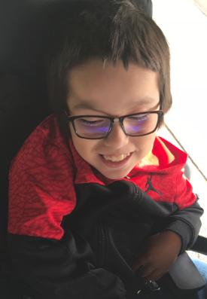
Priority Users
MEP Districts
Tonasket
Brewster
Pateros
Manson
Bridgeport
Lake Chelan
Cascade
Cashmere
Eastmont
Wenatchee
Orondo
Ephrata
Quincy
Moses Lake
Warden
Non-MEP Districts
Oroville
Omak
Okanogan
Entiat
Waterville
Palisades
Soap Lake
Nespelem
Grand Coulee Dam
Migrant Youth Vision Screening Programs

Slide 10
Program Priority Targets
NCW Migrant Youth Vision Screening Programs and Events
School districts that participate in the Washington State Migrant Education Program (MEP)
School districts with migrant students that do not participate in MEP
All other school districts
Students outside WA State requirements – Grades 4, 6, 8, 9, 10, 11 and 12, including eligible out-of-school youth

Slide 11
Program Requirements
Adhere to NCESD Lending Library vision screener policy and procedures.
Demonstrate competency in use of the Spot Screener.
Train other personnel before screening event.
Restrict screener use to trained personnel.
Maintain responsibility for equipment safety and appropriate use.
Coordinate, collect, and report migrant student vision screening and referral data with the ESD MEP Coordinator/Out-of-School Youth Coordinator.

Slide 12
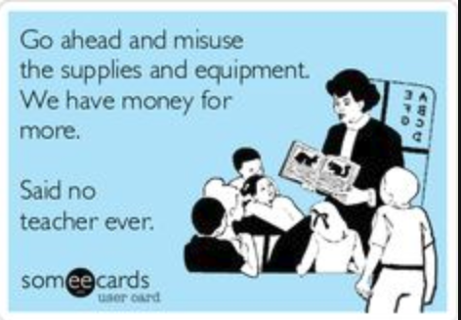
…………or school nurse or librarian or ………….

Slide 13
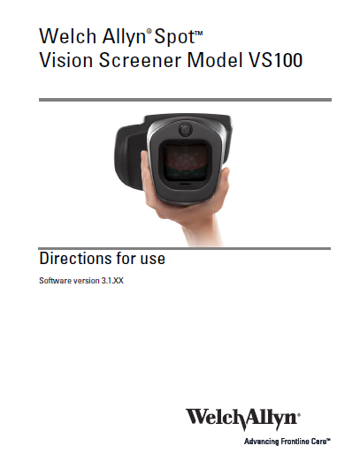
Equipment Kit
Welch Spot Vision Screener
Thumbdrive
Vision Screener Use Manual
Vision Screener Quick Guide
Program Specific
WA State Optotype-Based Screening Kit
Printer

Slide 14
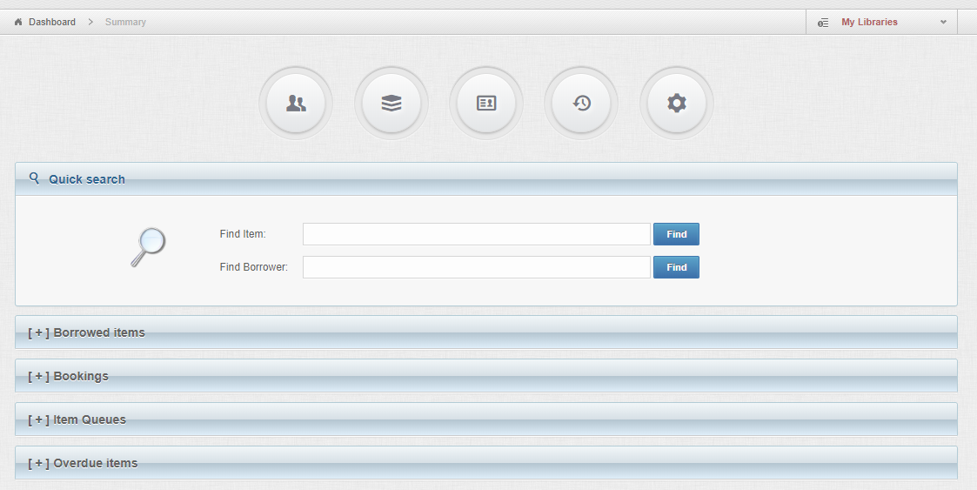
Reservation Process
Migrant Youth Vision Screening Events and MEP Districts have priority reservation time period – August and September – then reservations open to all users
SNC Lending Library “ Lend Items” has a kit description and reservation calendar
Contact: Raquel Ellis, NCESD

Slide 15
Check Out and Return
Equipment will be cleaned and checked by NCESD prior to distribution.
1 unit per borrower during peak use months (September – December).*
2 week maximum.
Pick up day: Tuesday. Return day: No later than Friday.*
Borrower must pick up and return unit to NCESD in Wenatchee.*
Complete Use Form. (Borrower, Event/District Name, Event Date(s), total number screened, total number migrant youth screened, any equipment problems reported, all equipment and thumb drive returned)
* Unless other arrangements are made.

Slide 16
Event Coordination
Schedule screenings collaboratively with surrounding districts to maximize resources and equipment access.
Train others on proper use of equipment and vision screening process.
Ensure screening environment.
Download data from thumb drive on completion.

Slide 17
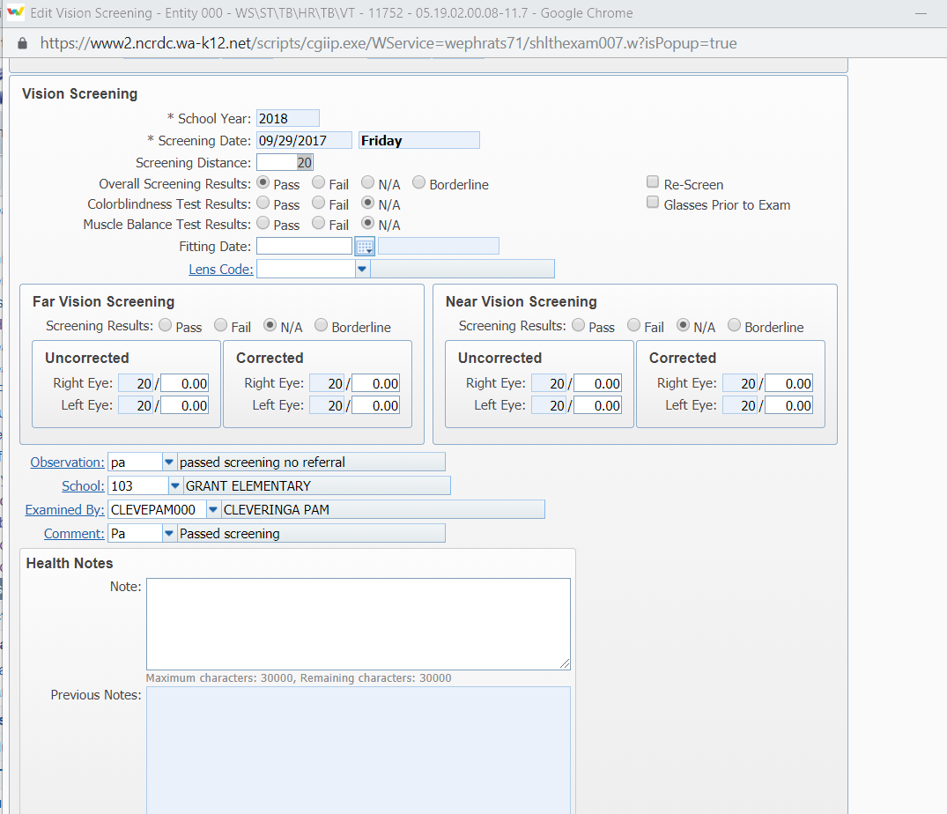
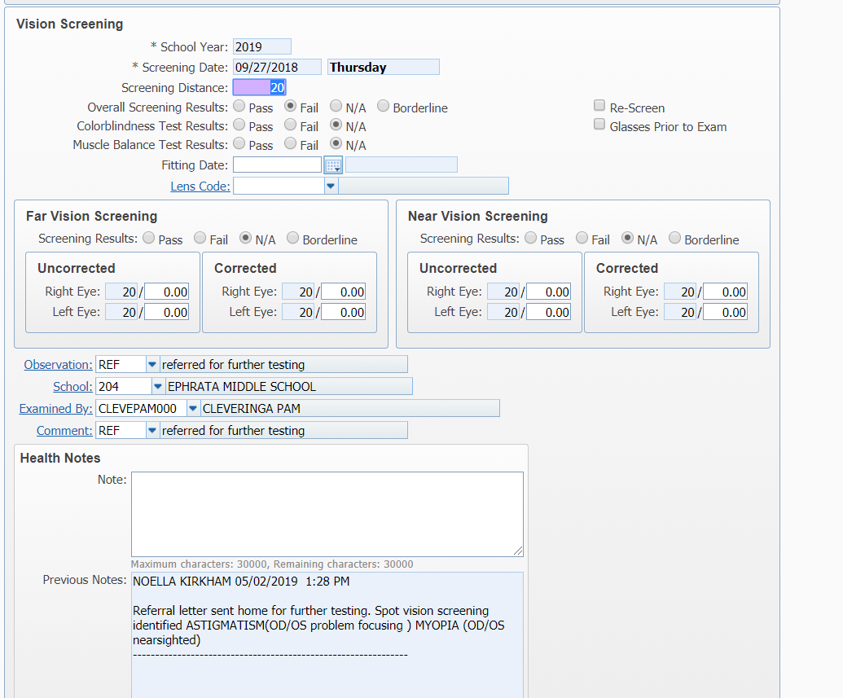
Skyward Documentation

Slide 18
MEP Documentation
All migrant student vision results and referrals must be documented in the Migrant Education Program (MEP) system.
Provide screening and referral information to the district’s MEP coordinator or NCESD Migrant Education Health Coordinator.

Slide 19
Resources
Medical Device Depot: Spot Vision Screener Demo (9:26) https://www.youtube.com/watch?v=v19n1r88LQA
How to Create and Import a Patient List (5:56)
https://www.youtube.com/watch?v=y6P9iPTVZac
Connecting Spot Screener to a Wireless Direct Printer (13:23) https://www.youtube.com/watch?v=BuCPPRgNZ0I&t=11s
Prevent Blindness
http://visionsystems.preventblindness.org/
American Association for Pediatric Ophthalmology and Strabismus
https://aapos.org/education/allied-health

Slide 20
Resources
Children’s Vision and Eye Health: A Snapshot of Current National Issues. National Center for Children’s Vision and Eye Health Prevent Blindness. (2011)
Principles for Practice: Vision Screening and Follow-Up. Bobo, Nichole. National Association of School Nurses (NASN). Provides practice tools for school nurses. Discusses vision screening and the referral process in the school setting in alignment with NASN's Framework for 21st Century School Nursing PracticeTM. (2016)
To See or Not to See: Screening the Vision of Children in School. Proctor, Susan E. National Association of School Nurses (NASN). (2005)
WAC 246-760-001 and 010 – Purpose and application of screening standards and terminology.
WAC 246-760-070, 071, 080 and 100 – Visual Acuity Standards

Slide 21
Contacts
Raquel Ellis, Administrative Assistant
North Central ESD
raquele@ncesd.org
509-665-2636
Ric Escobedo, Migrant Education Program Coordinator
North Central ESD
rice@ncesd.org
509-888-7040
Cathy Meuret, School Nurse Corps Nurse Administrator
North Central ESD
cathyme@ncesd.org
509-668-2934

